Slide 1

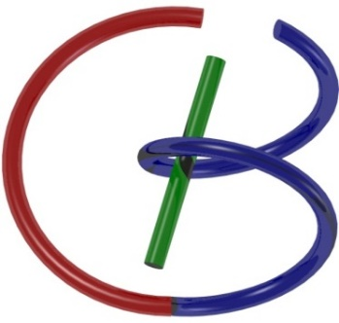
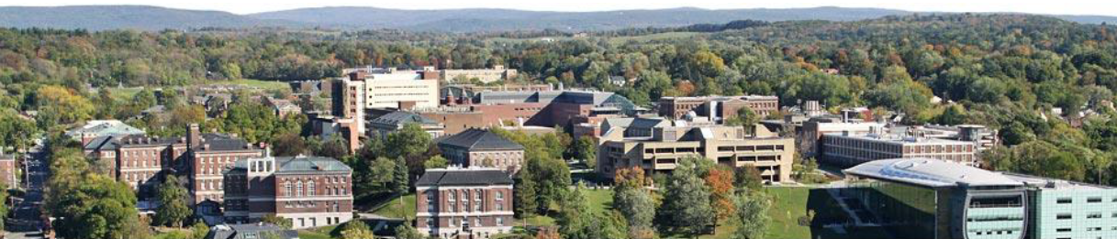
CT Physics
Ge Wang
AI-based X-ray Imaging System (AXIS) Lab
Rensselaer Polytechnic Institute, Troy, New York, USA
September 1, 2023
Notes:
Hello, since Professor Wang has a conference today out of town, I will give this hands-on introduction based on this PPT we prepared together. As he mentioned last time, we will have deep learning final projects by the end of the semester. Tentatively, we will have five lectures on deep learning hands-on, including this one.

Slide 2


Slide 3
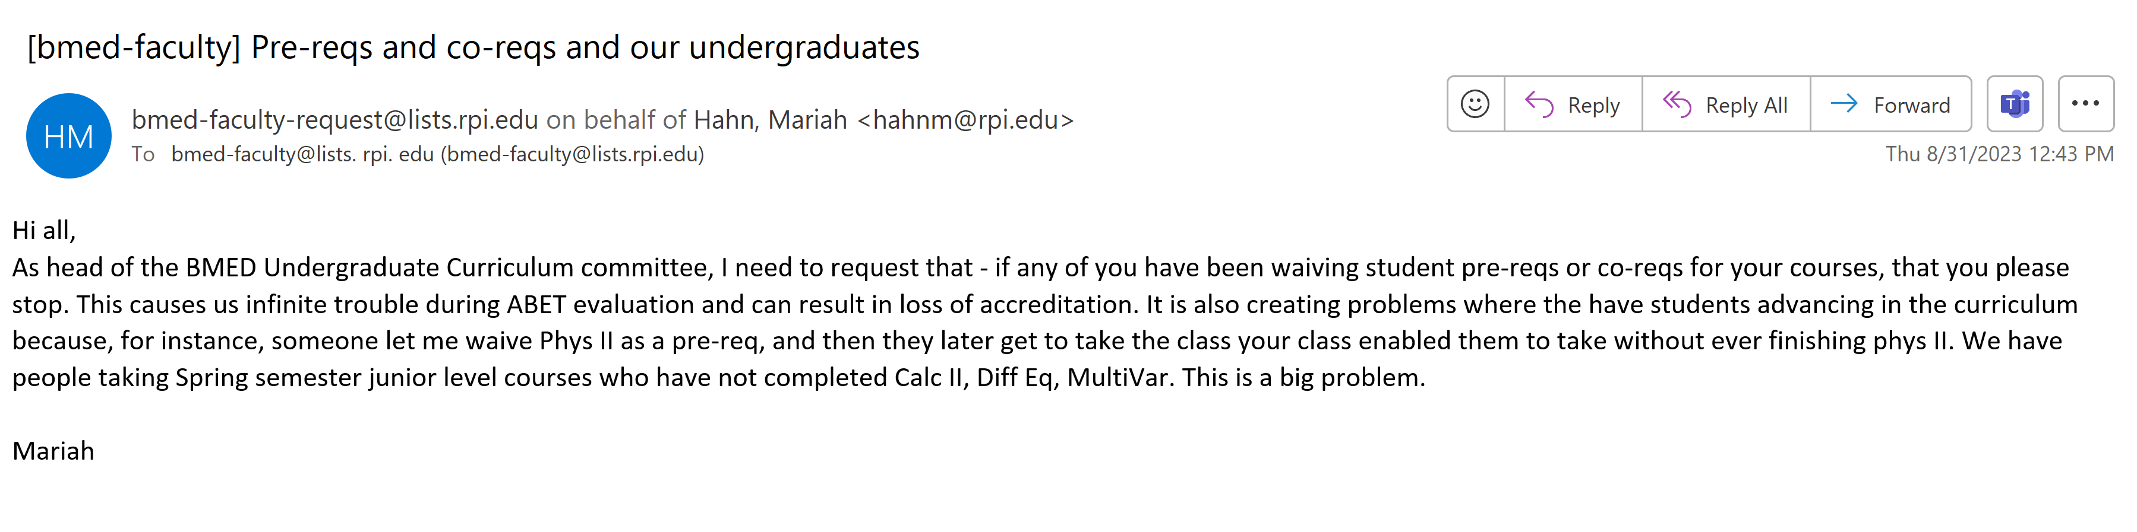

Slide 5
Outline
X-ray Nature
Wave
Particle
X-ray Attenuation
Mechanisms
Beer’s Law
X-ray Tubes/Sources & Detectors
Sources & Detectors
X-ray Radiography
Radiation Dose
Dosimetry
Low-dose CT

Slide 6
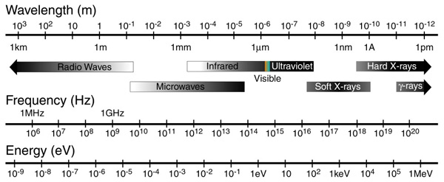
X-ray Waves
0.01-10nm
https://nau.edu/cefns/labs/electron-microprobe/glg-510-class-notes/signals/%23Absorption_of_electromagnetic_radiation

Slide 7
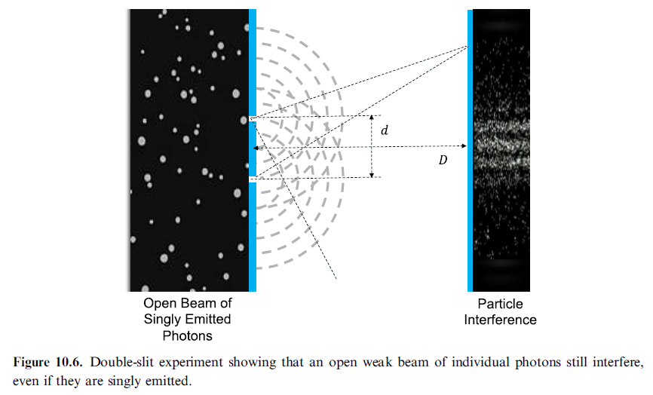
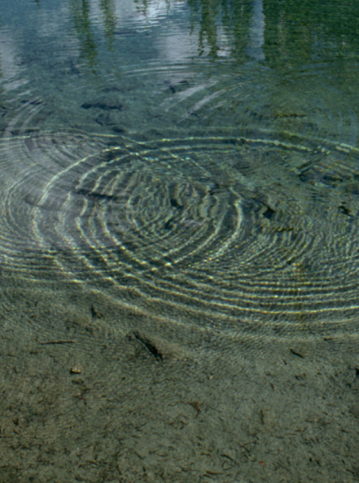
X-ray Interference

Slide 8
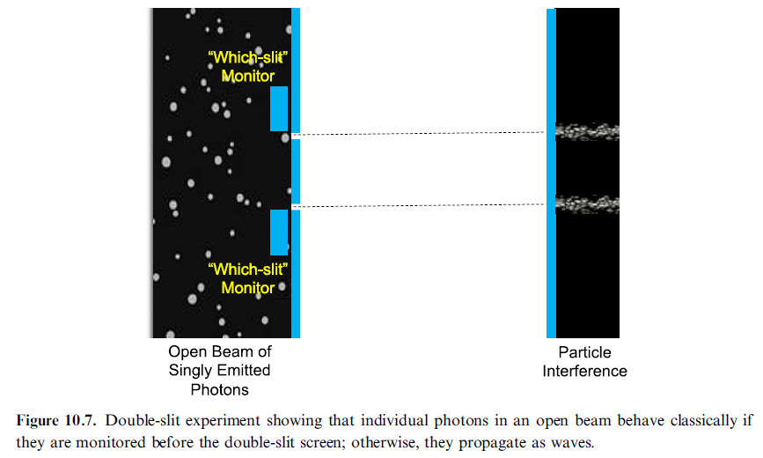
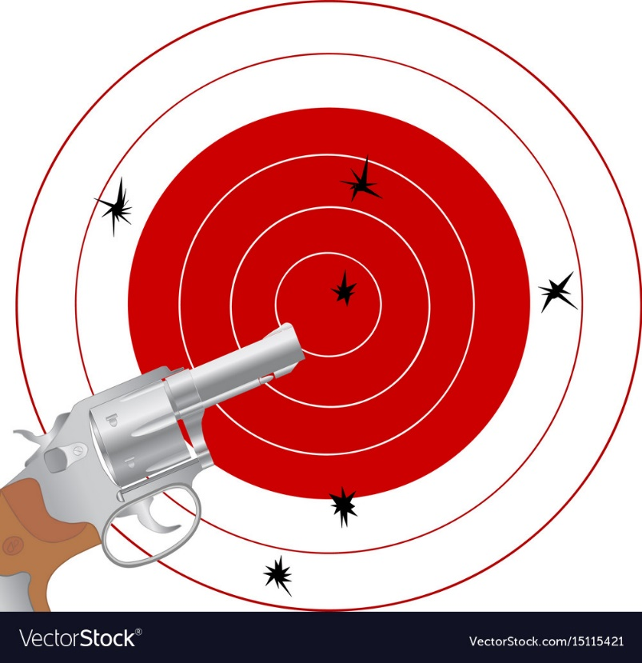
X-ray Photons

Slide 9
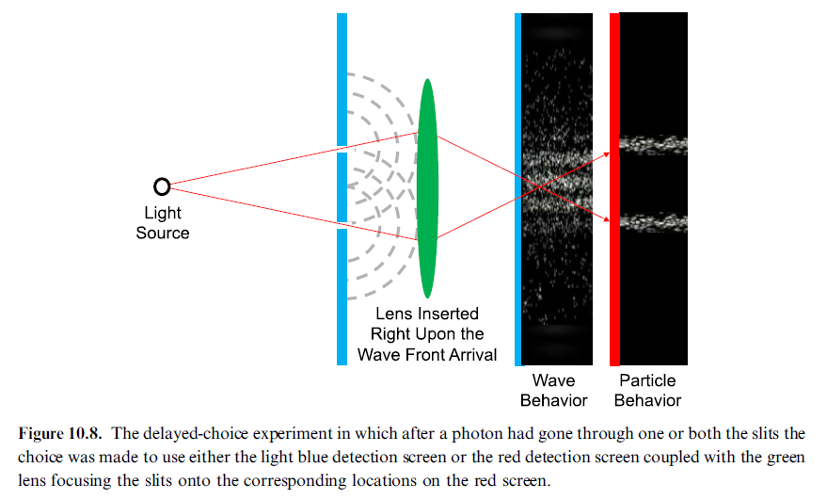
Delayed-Choice Experiments

Slide 10
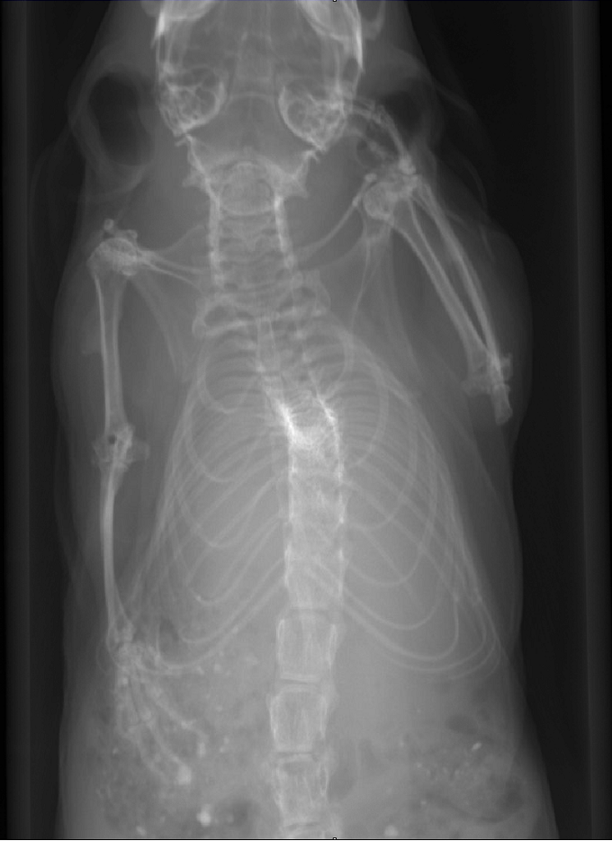
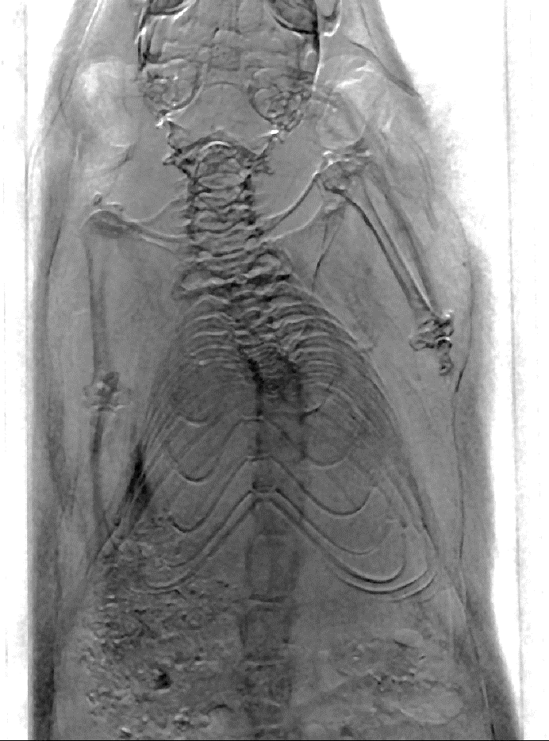
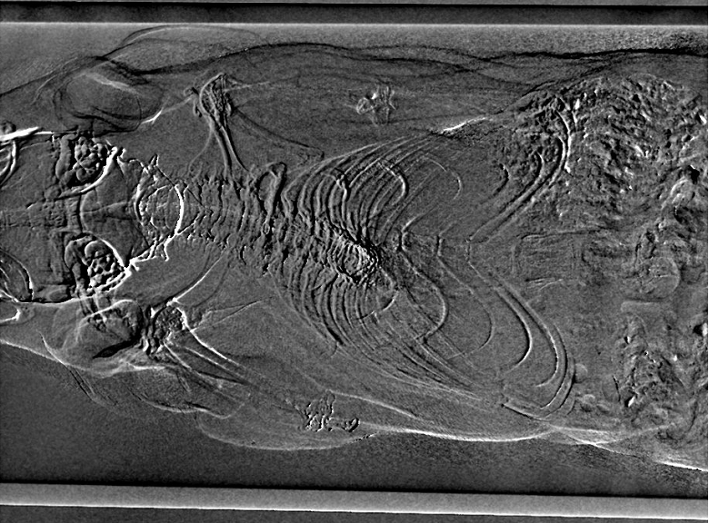
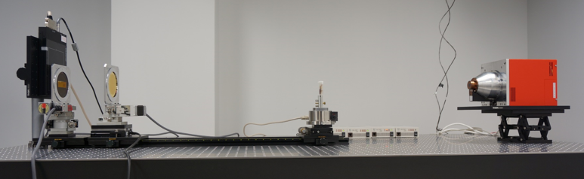
X-ray Grating Interferometric Results
Attenuation
Phase-contrast
Dark-field
Trachea Invisible in Attenuation
Cartilage
Texture of Muscle
Hair Invisible in Attenuation

Slide 11
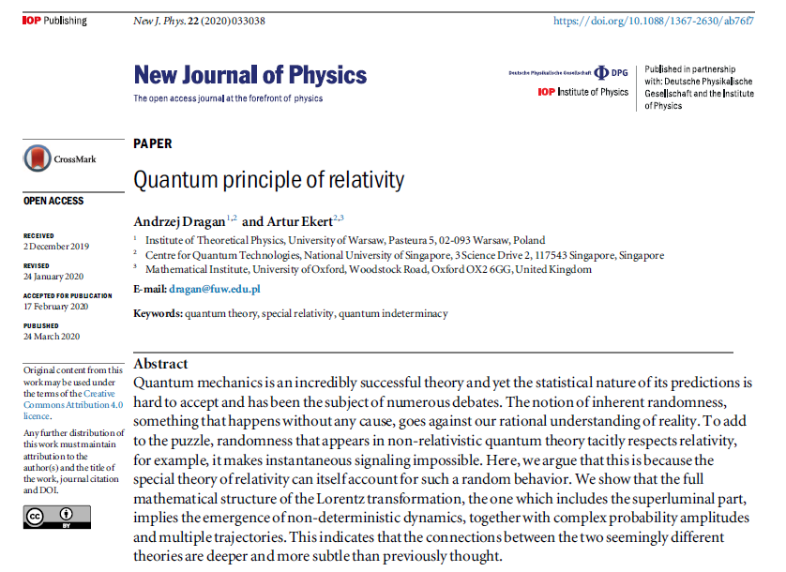
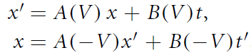
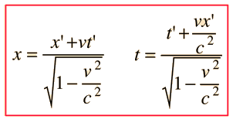
Quantum Principle of Relativity
The 1st postulate (Relativity)
The physical laws are the same in all inertial frames.
The 2nd postulate (Speed of Light)

Slide 12
Outline
X-ray Nature
Wave
Particle
X-ray Attenuation
Mechanisms
Beer’s Law
X-ray Tubes/Sources & Detectors
Sources & Detectors
X-ray Radiography
Radiation Dose
Dosimetry
Low-dose CT

Slide 13
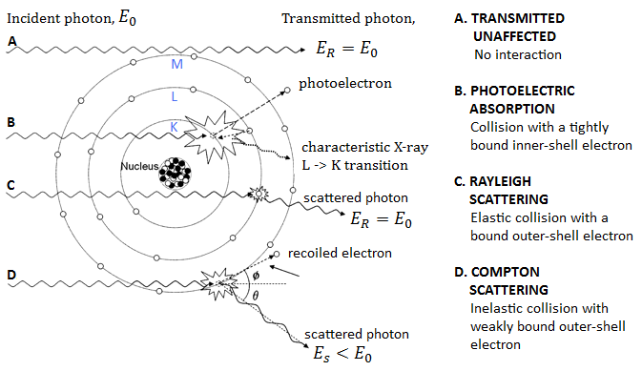
X-ray Interactions with Matter
Types of Interaction between an X-ray photon and the atom of irradiated matter
for x-ray beam energy 15-150keV (adapted from Seibert J.A and Boone J.M., 2005)

Slide 14
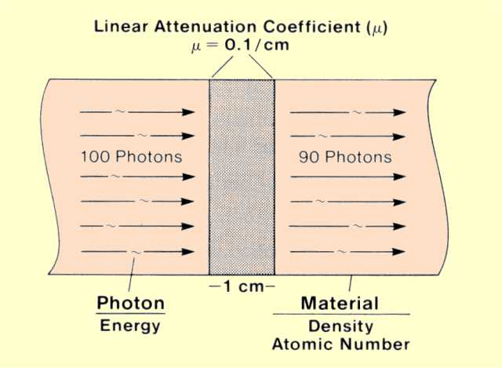
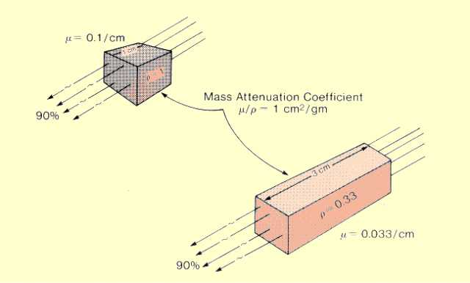
Linear & Mass Attenuation
The Same Amount of Material
http://www.sprawls.org/ppmi2/INTERACT/

Slide 15
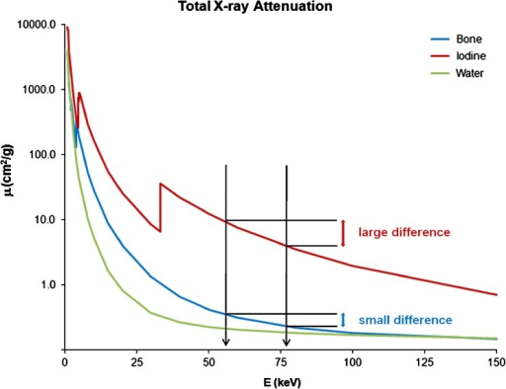
X-ray Attenuation Curves
It Depends on Both Material and Energy!
https://openi.nlm.nih.gov/detailedresult.php?img=PMC3259372_13244_2010_57_Fig1_HTML&req=4

Slide 16
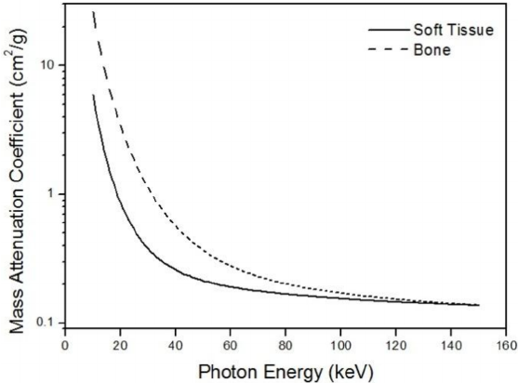
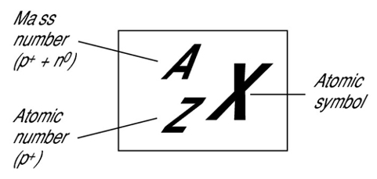
Two Basis Functions
Material
Energy

Slide 17
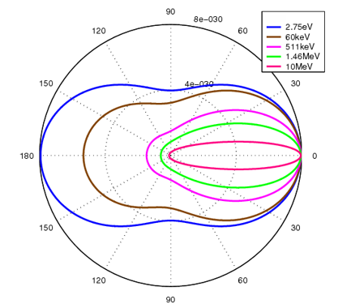
Klein–Nishina Function
Klein–Nishina distributions of scattering over a range of x-ray energies
https://en.wikipedia.org/wiki/Klein%E2%80%93Nishina_formula

Slide 18
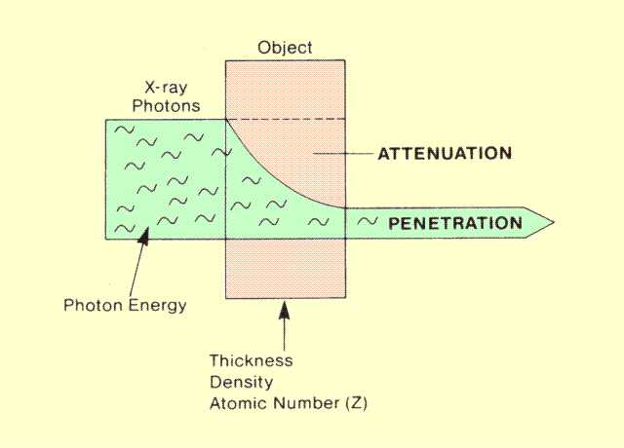
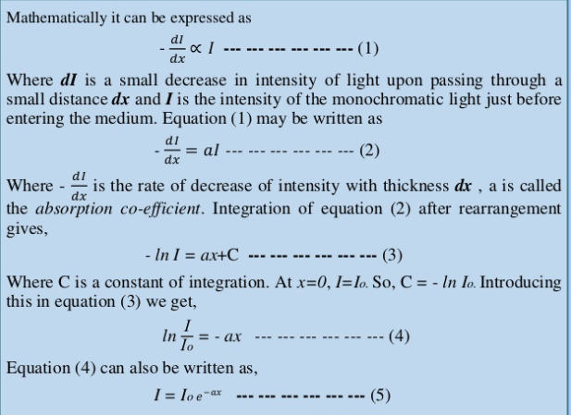
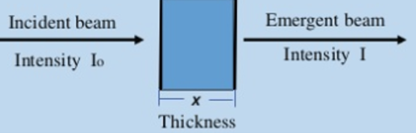
Beer’s Law (Monochromatic Light)
http://www.sprawls.org/ppmi2/RADPEN/
https://www.slideshare.net/MorshedulHaque/beer-lamberts-law

Slide 19
Mono- & Poly-Data Models
Spectrum
Energy

Slide 20
Outline
X-ray Nature
Wave
Particle
X-ray Attenuation
Mechanisms
Beer’s Law
X-ray Tubes/Sources & Detectors
Sources & Detectors
X-ray Radiography
Radiation Dose
Dosimetry
Low-dose CT

Slide 21
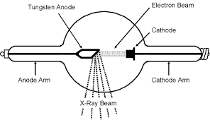
X-ray Tube: Simple View
kVp
http://www.dmlp.org/legal-guide/fair-use

Slide 22
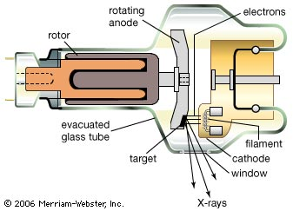
X-ray Tube: Pretty View
kVp

Slide 23
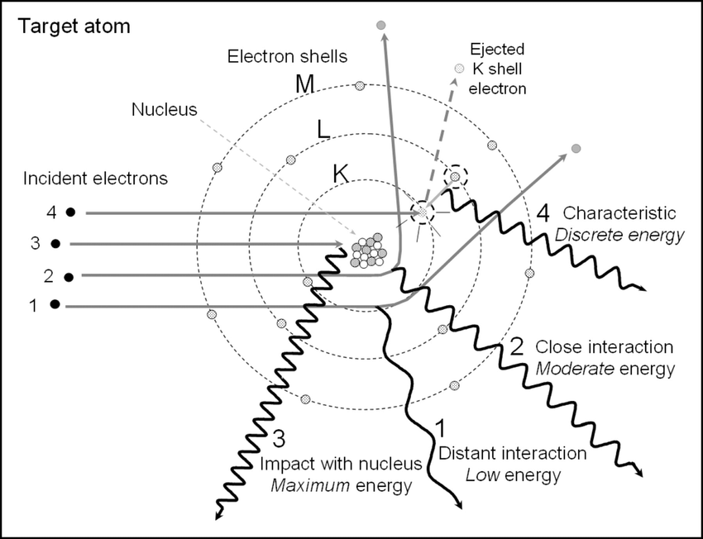
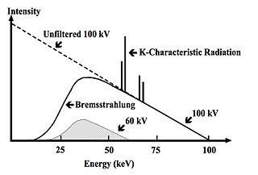
X-ray Spectrum
AU - Roque, Rita
PY - 2018/06/13
T1 - X-ray imaging using 100 μm thick Gas Electron Multipliers operating in Kr-CO2 mixtures
DO - 10.13140/RG.2.2.16794.49600
kVp

Slide 24
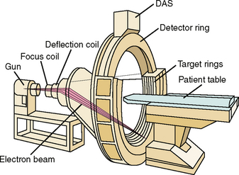
E-beam Scanner

Slide 25
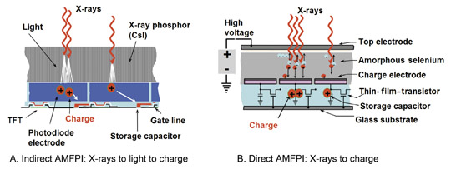
Energy-integrating Detector

Slide 26
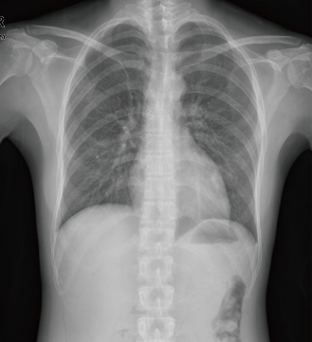
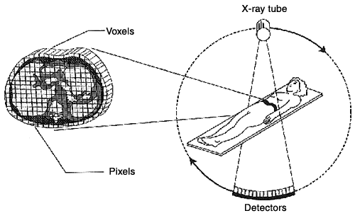
Beer’s Law to Linear Equation

Slide 27
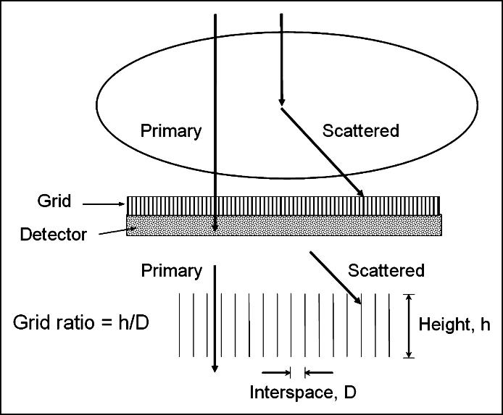
Anti-scatter Grid
With Grid
Without Grid

Slide 28

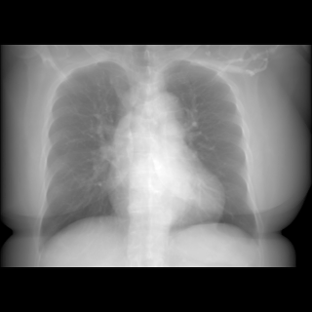
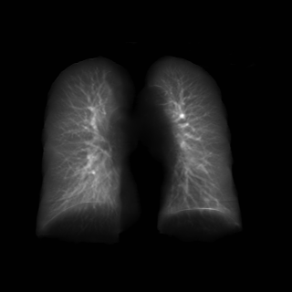
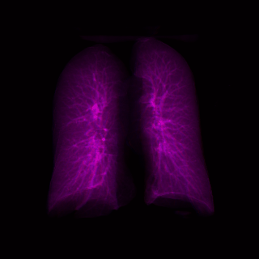
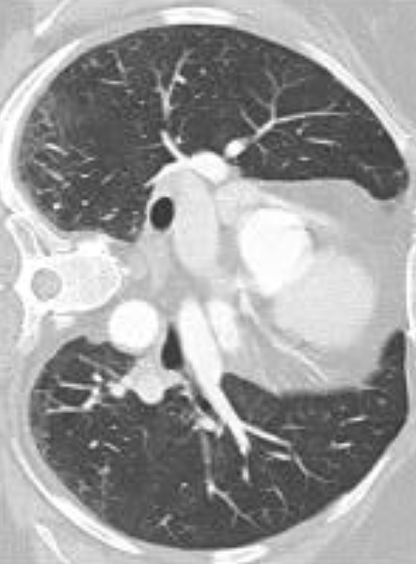
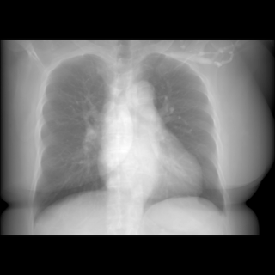
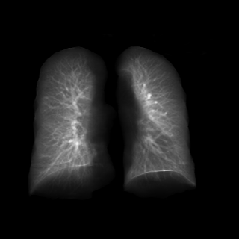
X-ray “Dissectography” / X-ray Stereography

Slide 29
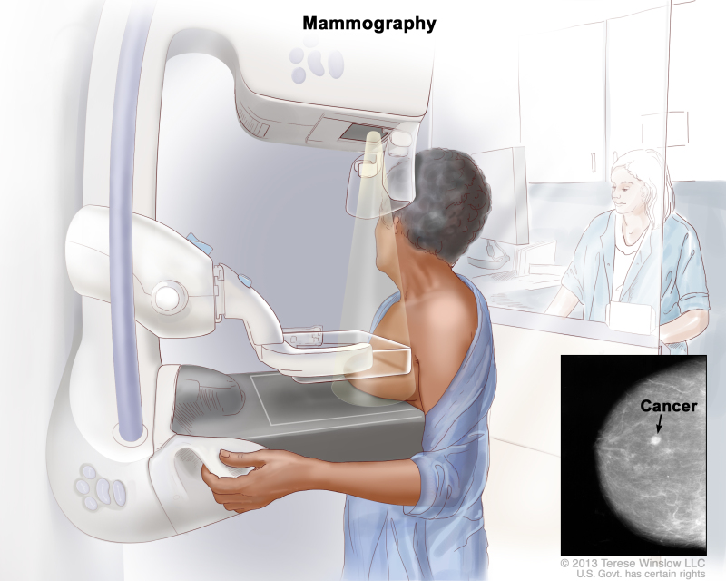

Radiography/Mammography

Slide 30
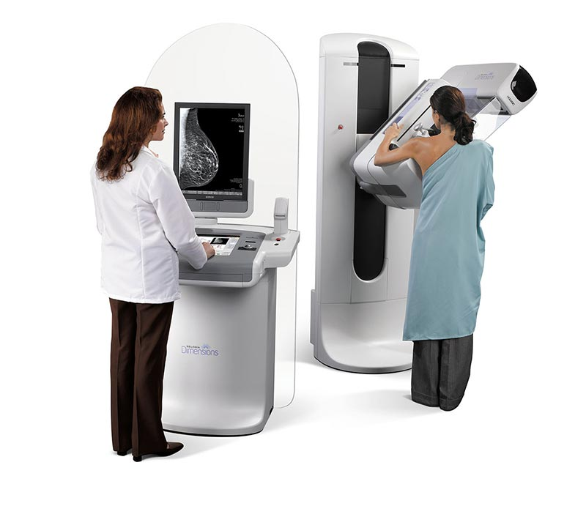
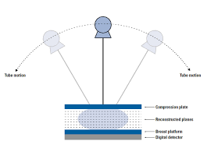
Breast Tomosynthesis
20-49kVp

Slide 31
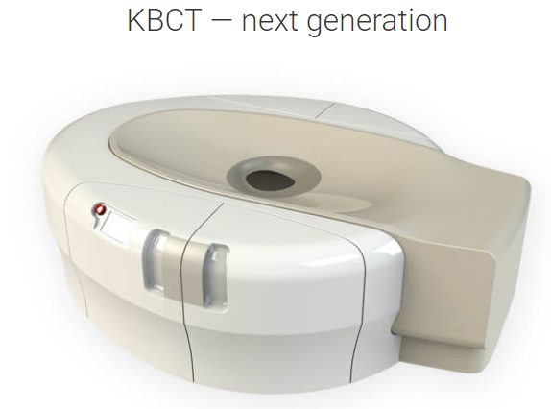
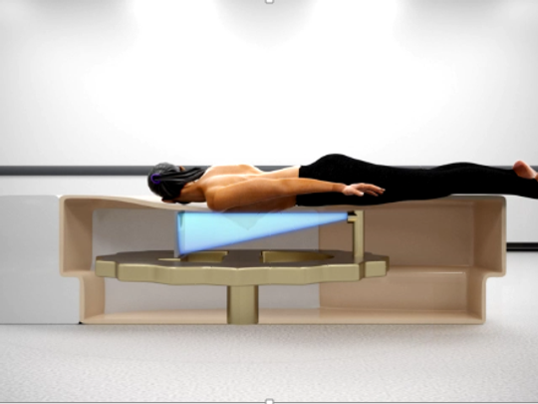
Breast CT
49kVp, 200mA, 8ms Pulse Width

Slide 32


Mathematical Insight
Radiography
(Single View)
Tomography
(Full Scan)

Slide 33
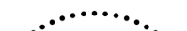
Mathematical Insight
Radiography
(Single View)
Tomosynthesis
(Limited Angle)
Tomography
(Full Scan)

Slide 34
Physical Insight
20-49kVp
49kVp
Radiography
(Lowest kVp)
Tomosynthesis
(Modest kVp)
Tomography
(Highest kVp)

Slide 35
Ballpark Analysis
Key Points
kVp should be low to maximize Δµ
kVp should be high to minimize noise

Slide 36
Outline
X-ray Nature
Wave
Particle
X-ray Attenuation
Mechanisms
Beer’s Law
X-ray Tubes/Sources & Detectors
Sources & Detectors
X-ray Radiography
Radiation Dose
Dosimetry
Low-dose CT

Slide 37
Ionizing Radiation Effects
Ionizing: Free Electrons in Biological Tissue
Stochastic Risks
Cell Injury/Death
Cell Modification toward Malignancy or Genetic Damage
Deterministic Damages
Complete Tissue Damage above a Threshold
Severe Tissue Reaction
Potential Benefits??
Evolutionary?
Dropout Effect?

Slide 38
Equivalent Dose (Radiation Normalized)
Absorbed Dose D [Gray (Gy)]
1 Gy = 1 J/kg
Cataract Risk per 5 Gy: 100%
Equivalent Dose H_{T} in Tissue t [Sievert (Sv)]
H_{t} = Σ_{r} c_{r}D_{t,r}
D_{t,r}: Absorbed Radiation of Type r in Tissue of Type t
c_{r} : Weighting Radiation (1 for X-ray, 20 for α Particles)
1 Sv = 1 Gy * 1 (for X-ray, Others Made Equivalent to X-ray)
Lung Cancer Risk per Sv: 1.14%

Slide 39
Effective Dose (Radiation & Tissue Normalized)
Effective Dose E: Overall Detriment [in Sievert (Sv)]
E = Σ_{t}d_{t}H_{t}
d_{t} : Weighting Tissue
Lung, Breast: 0.12
Gonads: 0.08
Bladder, Liver: 0.04
Brain, Skin: 0.01

Slide 40
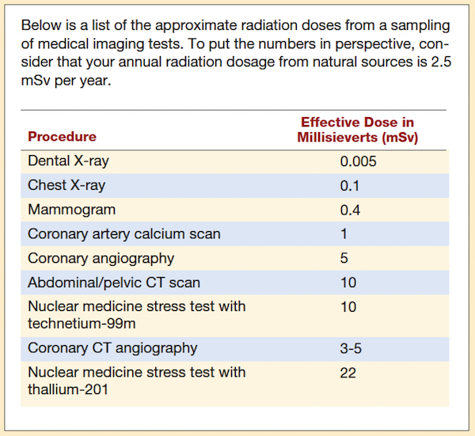
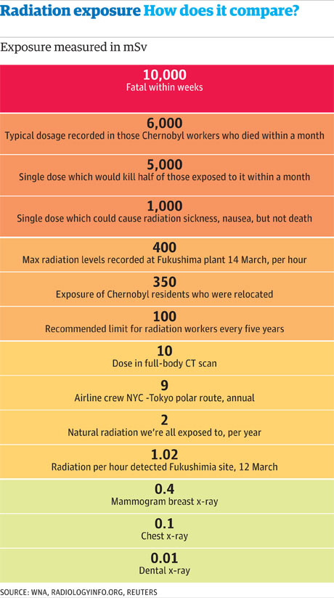
Effective Doses for Typical Imaging Exams
https://www.grepmed.com/images/1829/patientinfo-procedures-comparison-radiology-chestxray-radiation-imaging

Slide 41
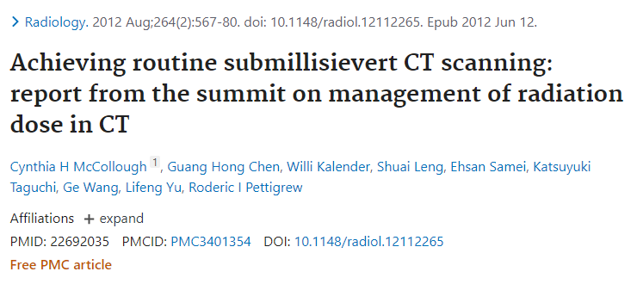

Low-dose CT

Slide 42


Out of Box Solution

Slide 43

Homework
Please discuss if we only take one x-ray radiograph of an object (say a breast), should we compress the object or not for better screening or diagnosis?

